Slide 1

Orienting
Extension Faculty that are Volunteer Administrators

Slide 2
We have all seen leadership positions become filled by someone new. Think about some of those situations.
Within your groups, give an example (either good or bad) of how that situation was handled by the new leader.

Slide 3
Think about a time when you have stepped into a leadership position, preferably within Extension.
Discuss examples of things you did well or things that you would do differently if you could go back.

Slide 4

Discuss something someone else did for you that was really helpful in your new position.

Slide 5
The Role of a Volunteer Administrator
Leading and managing individuals who are providing a service of their own free will (Fisher and Cole, 1993).
A volunteer administrator decides what needs to be done, creates networks of people and relationships that can accomplish a task, and then tries to ensure that those people actually get the job done (Kotter, 1990).

Slide 6
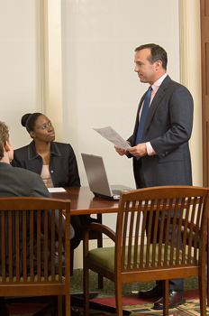
Who is an Volunteer Administrator?
Each of us who works with volunteers is a volunteer administrator.

Slide 7
Our Grand Challenge
Because each of us work with volunteers, we need to become effective volunteer administrators.
Start by focusing on the five core competencies required for volunteer administrators, identified by the Council for Certification in Volunteer Administration
These core competencies serve as the foundation for the profession of volunteer administration

Slide 8

What is a Core Competency?
The Council for Certification in Volunteer Administration defines them as:
“…the knowledge, skills and abilities required for competent/satisfactory practice in the field of volunteer resource management.”

Slide 9


Core Competencies for Volunteer Resource Management
Ethics
Organizational Management
Human Resources Management
Accountability
Leadership and Advocacy

Slide 10
Core Competencies Defined
Ethics: the ability to act in accordance with professional principles.
Organizational Management: the ability to design and implement policies, processes and structures to align volunteer involvement with the mission and vision of the organization.
Human Resources Management: the ability to successfully engage, train and support volunteers in a systematic and intentional way.

Slide 11
Core Competencies Defined
Accountability: the ability to collect relevant data and to engage in meaningful monitoring, evaluation and reporting to stakeholders.
Leadership and Advocacy: the ability to advocate for effective volunteer involvement inside of the organization and in the broader community it serves.

Slide 12
Role of Extension Faculty
The primary role of Extension faculty related to volunteers is to guide and support them in meeting the mission of Extension.
This will “look” different when working with various types of Extension volunteers, such as:
  Associations, committees or groups
  Master Volunteers
  Random/Episodic volunteers

Slide 13


Functions of Extension Faculty
Related to associations, committees, groups or episodic volunteers:
  Serve as advisor
  Teach subject matter
  Provide and coordinate supporting services
  Maintain a county office
Notes:
The main role of Extension faculty is to guide and support a volunteer association or group in meeting the mission of Extension. Extension faculty
• serve as advisors to the association;
• teach subject matter that supports the mission of Texas Extension and the association;
• provide and coordinate supporting services to the group; and
• maintain a county office, with the cooperation of the County Commissioners’ Court, where people can learn about the association and where information related to the program area can be recorded and distributed.

Slide 14
Functions of Extension Faculty
Related to Master Volunteer (MV) groups:
  Carry out all duties related to groups, plus….
  Recruit and select candidates for program
  Fund and conduct training for candidates
  Certify and recertify MV’s according to guidelines
  Guide activities and projects of the MV’s
  Approve, record & report service of MV’s
  Recognize MV’s for their service and leadership
  Facilitate communication with Extension & MV’s
Notes:
In the case of master volunteer associations, faculty
• recruit and select candidates for the master volunteer program;
• fund and conduct training for master volunteer candidates;
• certify and recertify master volunteers according to the appropriate guidelines;
• help determine what activities and projects the master volunteer candidates will carry out to support Extension’s educational mission;
• approve, record and report the service of master volunteers;
• recognize master volunteers for their service and leadership; and
• facilitate communication between Extension personnel and master volunteers.

Slide 15


Items to Consider
Recruiting tools
  Previous PSAs, news releases or promotional materials
Selection tools/practices
  Personal information sheets or application forms
  State guidelines or recommendations for interviewing candidates

Slide 16
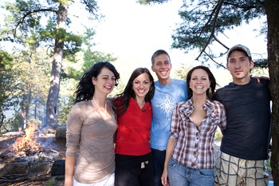

Items to Consider
Volunteer Orientation tools
  Position descriptions
  Informational meetings
Risk Management
  Handling money
  Youth protection standards

Slide 17
Application
Think about Extension colleagues that are within your sphere of influence and are new to an Extension volunteer resource management position.
List their name(s) as well as at least five action items that you can do in the near future to help them succeed in their new position.

Slide 18
Application
List each of the five core competencies given in this presentation for volunteer administrators.
Next, write down action points as to how you can improve in each of these areas.

